Slide 1
The agile dba toolbelt
Asheville, NC Beer city sql pass
https://github.com/shellninja/PASS-June

Slide 2
The agile dba Toolbelt
David Hawthorne Database Architect, GPM Corp.
All these facts are opinions and all the opinions are my own!
Email: david@davidhawthorne.com Linkedin: davidhawthorne.com Github: @shellninja StackOverflow: @ShellNinja
Notes:
Manage the Data Engineering Department at GPM: team of nine including Devops, DBAs, and a few full stack devs
Notice the personal flair here, thats because: All opinions are my own – and that’s a good thing because they are only a little less than wrong.
Spotify/Bose Quiest comfort joke

Slide 3

Some Quick Housekeeping
Framework
Sprints and standups
Buzzword
Agile is not a specific methodology or even a general framework [1]
Those are ceremonies where are generally part of an Agile framework called Scrum [2]
Possibly?
Notes:
I want us to all get on the same page before we dive In

Slide 4
GET TO THE POINT!
Agile is the ability of an organization to sense changes internally or externally and respond accordingly in order to deliver value to its customers. (see more)

Slide 5

AGILE IN TODAY’S ENVIRONMENT
remote work
The rise of DevOps
Keeping the lights on
Notes:
Empowering decentralized, self organizing teams
Devs have input into Ops, Ops has input into Dev. Everyone wins
We’re so too busy keeping the lights on to accomplish delivering products

Slide 6

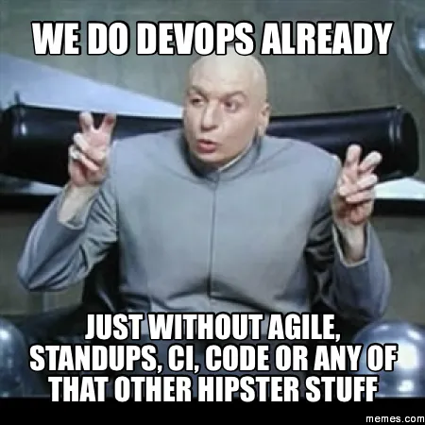
How to tackle
Standups, Retros, backlogs, working agreements
Tackle Technical Debt
Automation and Tooling
Notes:
Empowering decentralized, self organizing teams
Devs have input into Ops, Ops has input into Dev. Everyone wins
Barriers to adopting agile
We’re so too busy keeping the lights on to accomplish delivering products

Slide 7
Working agreements/ground rules
The best teams are the ones that are enabled to execute decisions rather than determining what decision to make.
Ground rules are simple guidelines that improve teamwork and communication. Ground rules may be also known as working agreements, team arrangements, shared expectations, and group understandings.
Notes:
ASAP Experiment
Examples from our team
Working in emergencies

Slide 8

Enough! Let’s move on!
Notes:
Bring a print out of elmo to your next meeting

Slide 9
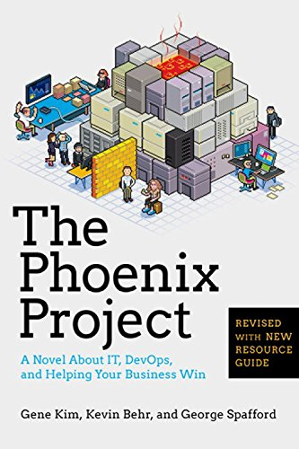
Technical Debt
Tracking Unplanned Work in backlog form –
Visualize it on a Gannt Chart
One Hour Minimum!
Groom and prioritize backlog at minimum weekly
Notes:
Not only in the phoenix project, also in Uncle bob

Slide 10
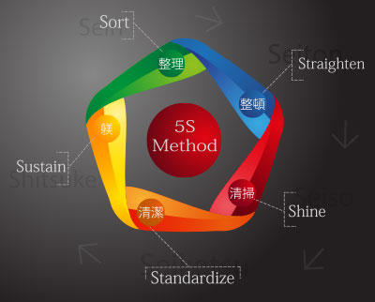
5S
Originated with Toyota
Common in manufacturing but has made it’s way like agile into retail, software, and other markets.
Notes:
Comes from Toyota. TPM.
Sort - through materials, keeping only the essential items needed to complete tasks
Set - Ensure that all items are organized and each item has a designated place.
Shine - Proactive efforts to keep workplace areas clean and orderly to ensure purpose-driven work.
Standardize - Create a set of standards for both organization and processes. In essence, this is where you take the first three S's and make rules for how and when these tasks will be performed.
Sustain - new practices and conduct audits to maintain discipline.
With that said, I want to pivot to some apps

Slide 11
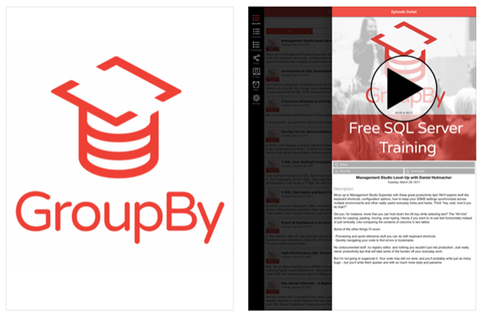
Groupby
GroupBy.org is free technical training by the community, for the community. Volunteer speakers submit abstracts at GroupBy.org and you – the attendee – vote to pick the sessions. Want to present your own session or just vote on others? Join us at GroupBy.org
https://apps.apple.com/us/app/groupby/id1227818396#?platform=ipad

Slide 12

Azure
+1 Microsoft’s RDP: perfect for on-call rotations
Don’t forget to turn off the lights
Notes:
GPU VM Story

Slide 13
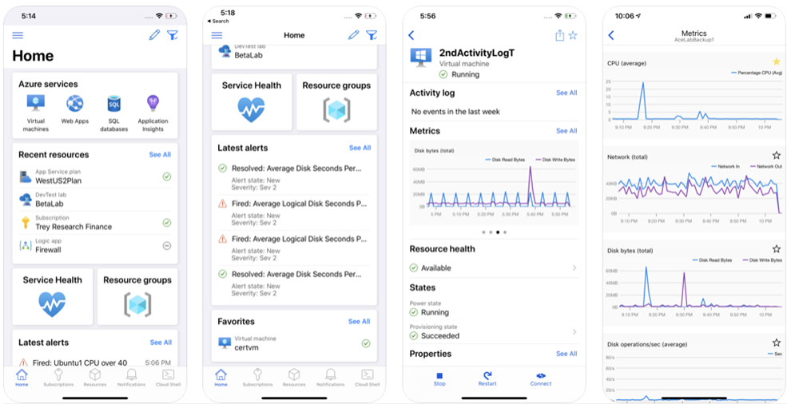

Slide 14

Automation
How many of you have an SSRS instance running?
Ever find yourself doing the same tasks to update a row due to a bug that still isn’t fixed?
When was the last time you wrote dashboards for your own DB?
Notes:
Load CSV Files
Update a row

Slide 15
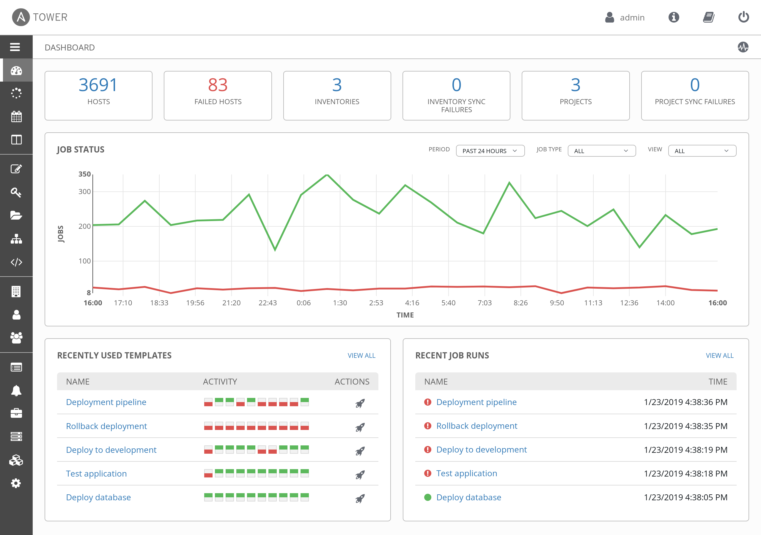
Automation Platforms
Ansible
IT Automation platform backed by RedHat
Zero Agents
Playbooks
Notes:
Perfect for testing DR, maintaining lower environments, managing resource costs

Slide 16
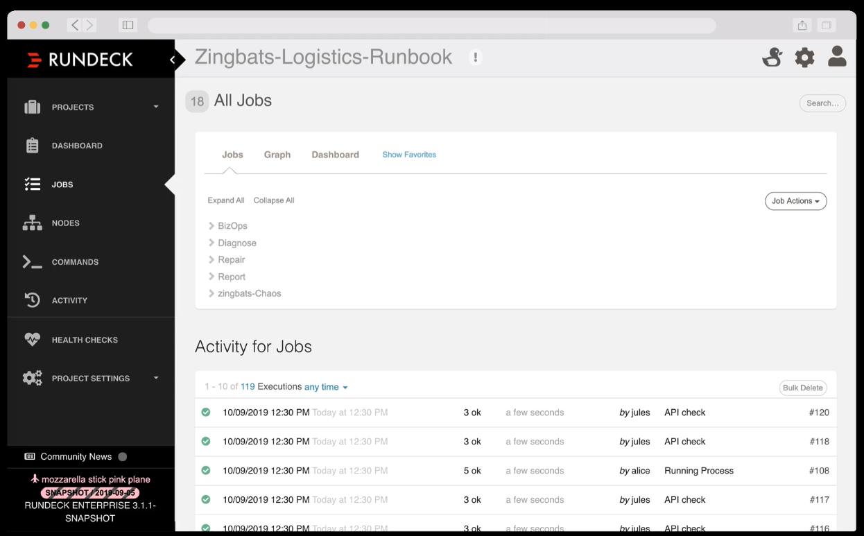
Automation Platforms
Rundeck [Link]
Ansible on Easy mode
“Runbooks” -> Jobs

Slide 17
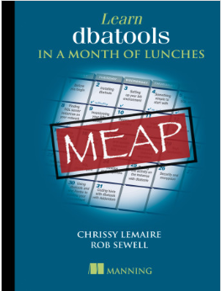

dbatools is a free PowerShell module with over 500 SQL Server best practice, administration, development and migration commands included. [Link]

Slide 18
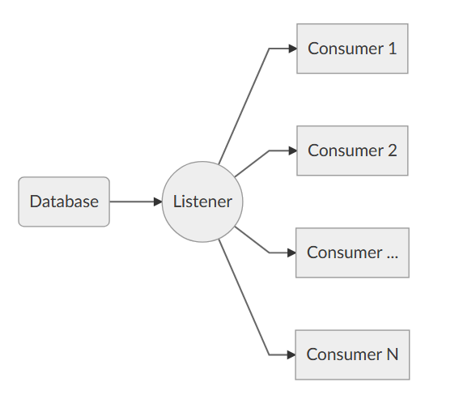
Testing better
A/B Testing DB performance pre-release using distributed replay
Workload Tools: https://github.com/spaghettidba/WorkloadTools

Slide 19
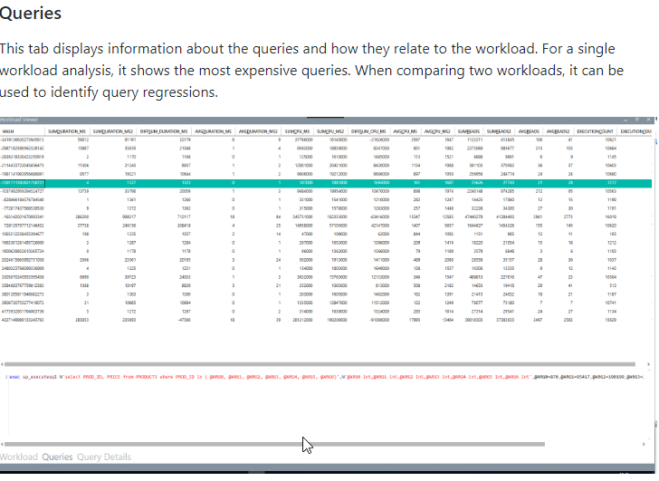
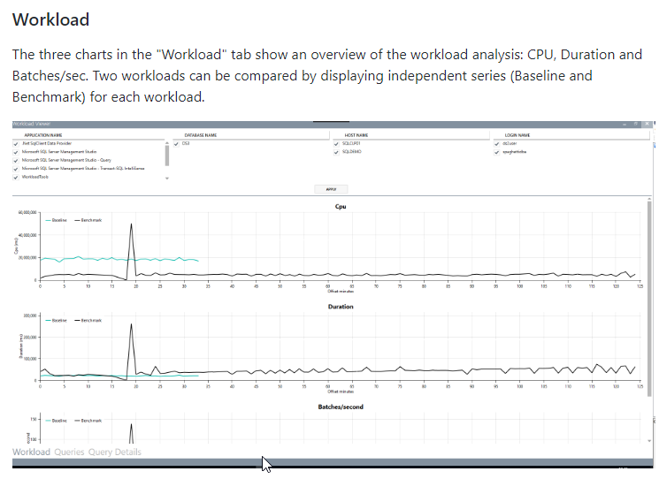
Analyze results
Query capture to schemas baseline/benchmark
Captures are more extensible

Slide 20
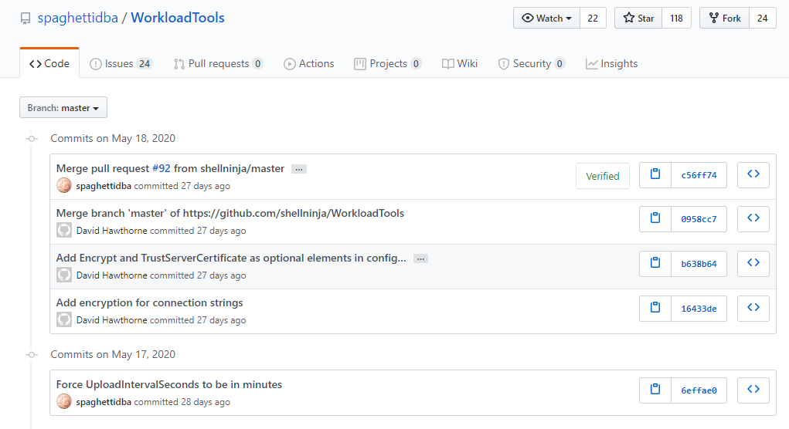
Notes:
Is it actively maintained? Yes, I am!
This brings up a good point - Github

Slide 21

Social Coding https://github.com/topics/ms-sql-server
https://github.com/microsoft/tigertoolbox
Microsoft’s Tiger Team for SQL Server
Deep dive into SQL Server internals
https://github.com/sergiisyrovatchenko/SQLIndexManager
GUI for index analysis and maintenance
https://github.com/SQLUndercover/UndercoverToolbox
The SQL Undercover Toolbox comprises of a collection of scripts, stored procedures and functions designed to make your life as a DBA easier.
Notes:
Start using source control

Slide 22

Monitoring tools
User friendly “Current Status”
Historical
Easily identifies issues and problems. Automated alerts
Notes:
What makes a good monitoring tool?

Slide 23
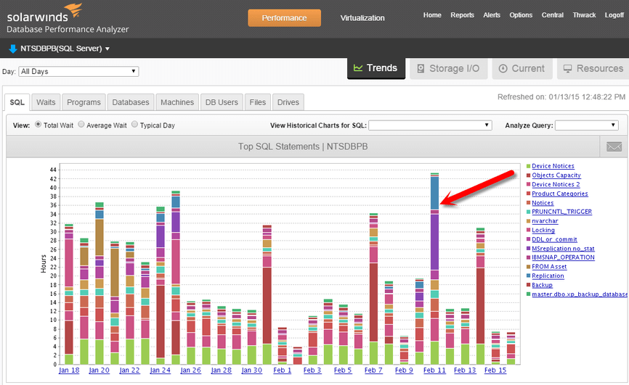
SOLARWINDS DPA
Focused on wait times
Historical Plan usage
Current Session, Storage I/O, etc.
Integrates with VMWare monitoring

Slide 24
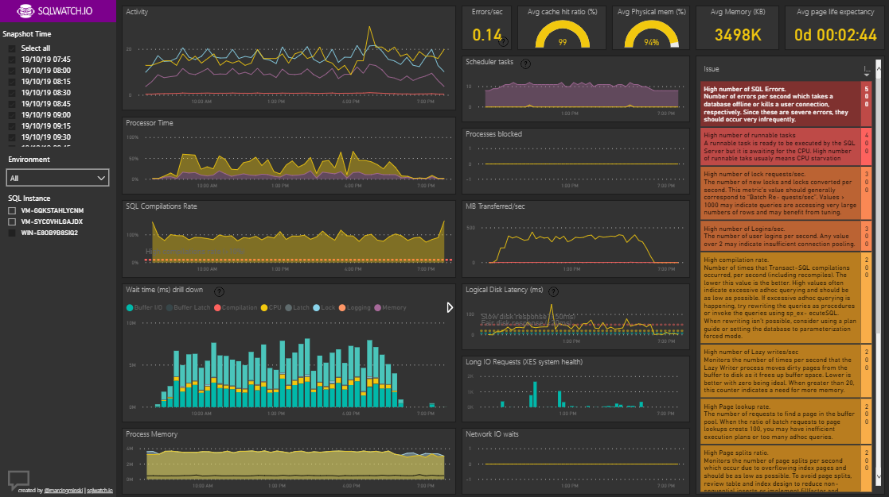
SQLWATCH.IO
Free
Requires agents – SQL Jobs
Good solution for capturing patterns from DMVs
PowerBI

Slide 25
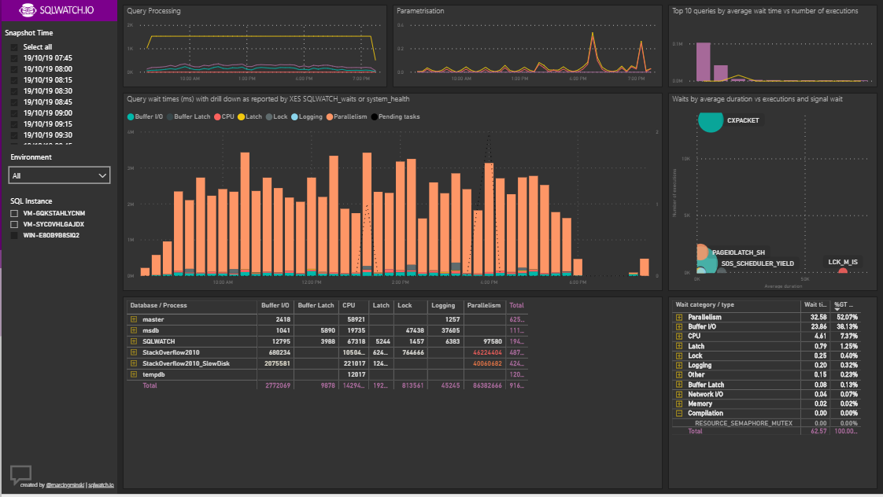

Slide 26
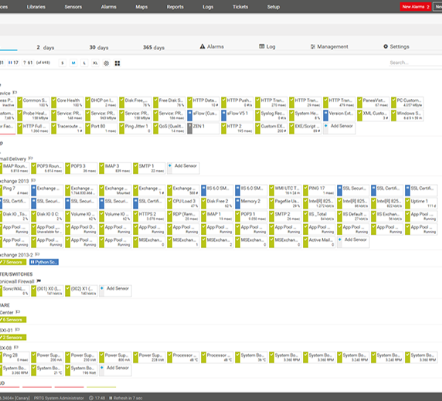
PRTG
Your IT department probably has an instance
Great for times when you need to track and report on historical performance data not easily captured in other ways
Has a SQL sensor that allows you to use your own scripts

Slide 27
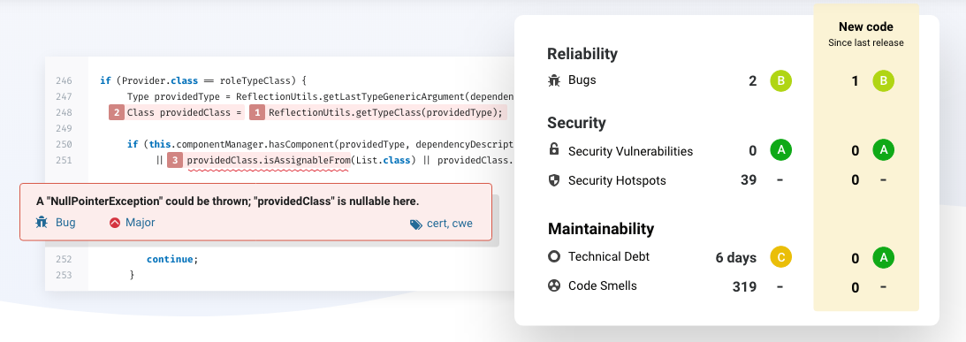
Static Code Analysis - Sonarqube

Slide 28
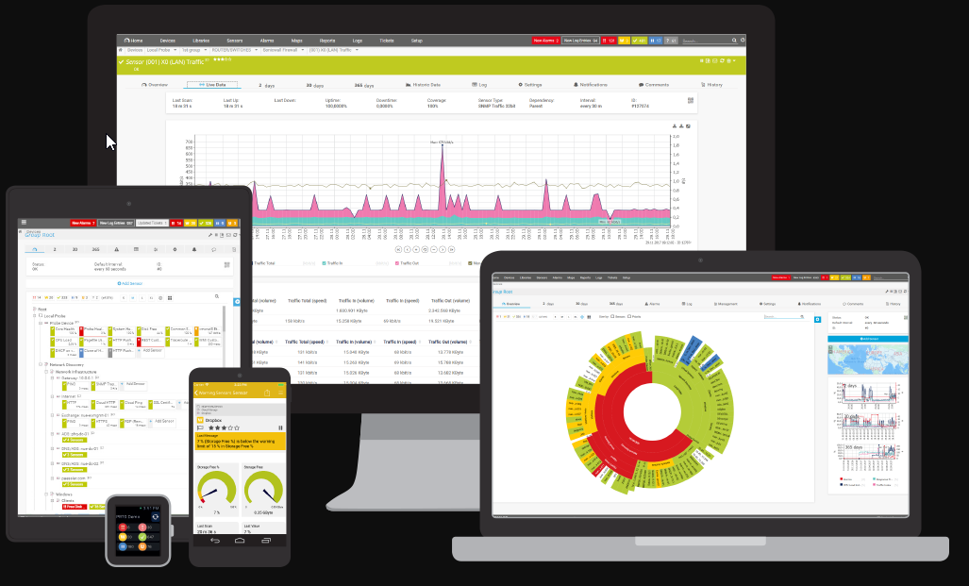

Slide 29
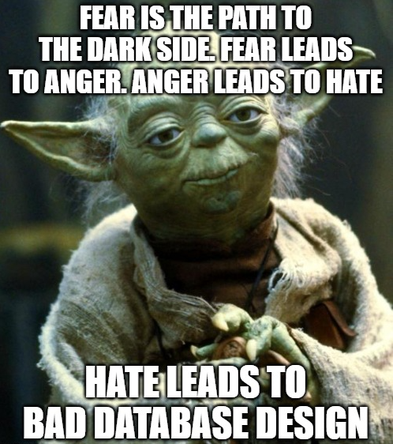
Development Tools & Utilities
Notes:
We’re past the point of spoiler’s for Skywalker right? What Rey should have realized

Slide 30
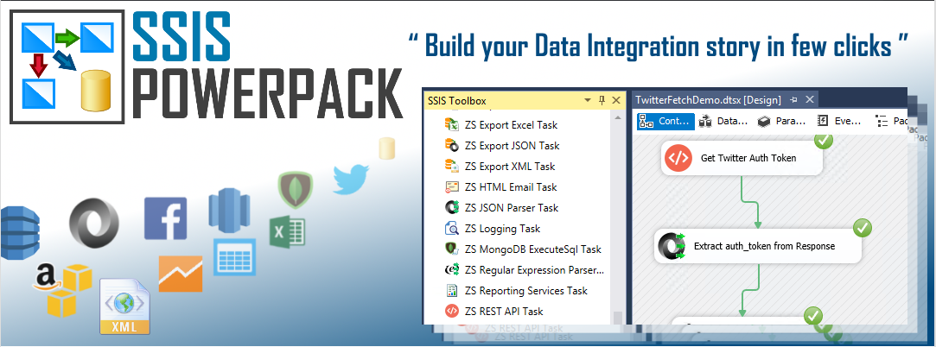
ZappySys for SSIS
Turns SSIS in to a drag and drop web development suite [link]
REST API Services, Azure Cloud, Amazon AWS Cloud, MongoDB, JSON, XML, CSV, Excel, Salesforce, Redshift, DynamoDB, Google API (i.e. Analytics, AdWords), SOAP/Web API, Facebook, Twitter, Zendesk, eBay and many more.

Slide 31
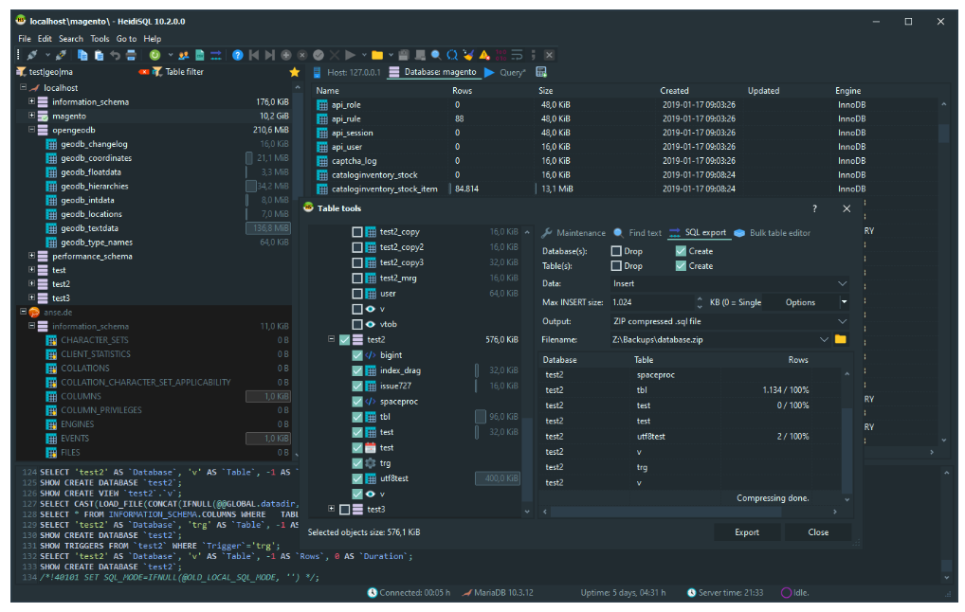
Heidisql [Link]
Works with almost any RDBMS
Neat features such as Export to Inserts, execute statements from file, etc.
Query History

Slide 32
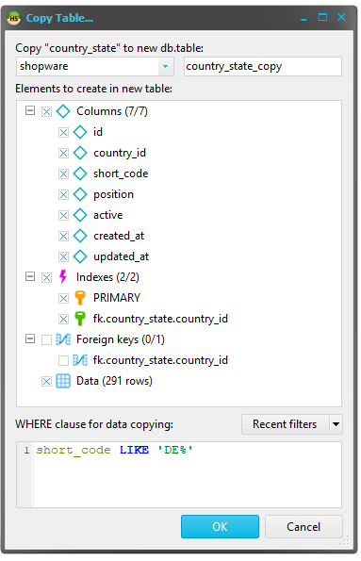
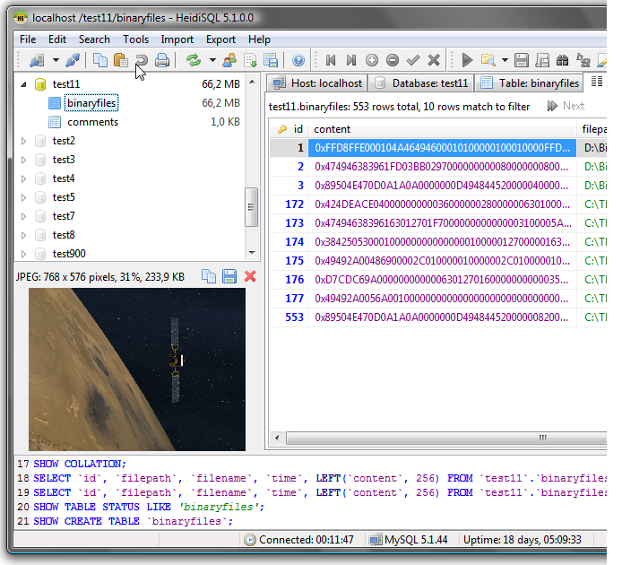

Slide 33
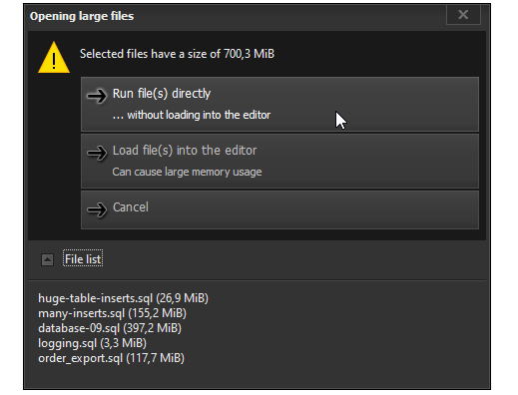
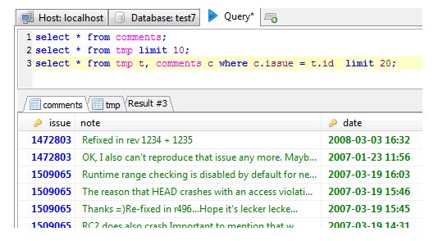
So many Cool Things
Multiple results sets the right way

Slide 34
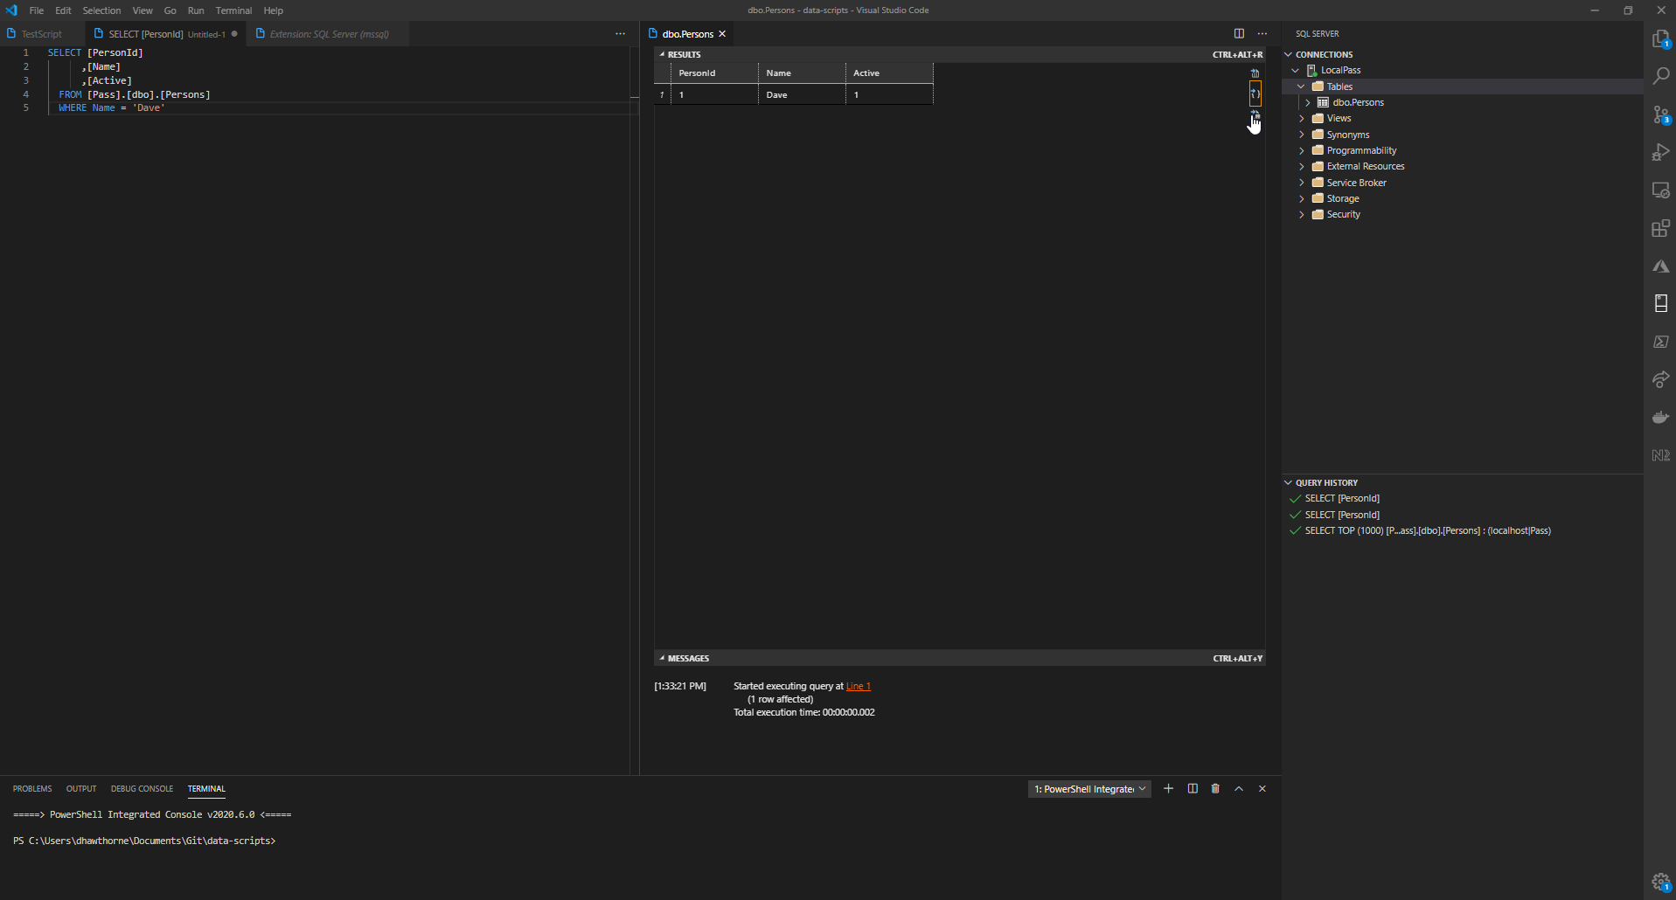
Vscode
Notes:
DEMO

Slide 35
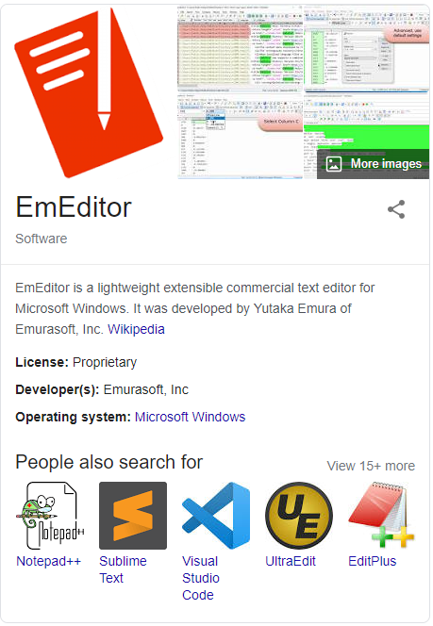
Large files made easy [Link]
Notes:
You could learn VI but this just works. Worlds fastest editor

Slide 36
Emeditor
EmEditor allows you to open very large files quickly, and the Large File Controller allows you to open only a specified portion of a large file.
EmEditor allows you to open CSV, TSV, or user-defined separator (DSV) files. You can sort according to column values (alphabetically or numerically), and you can configure sorting options such as stable-sort.
EmEditor allows you to split or combine files.
You can also use the bookmark features, so that you can bookmark lines that match certain criteria. Then you can delete those bookmarked lines, or extract bookmarked lines to a new file. The Delete Duplicate Lines command allows you to delete identical lines in a document.

Slide 37
